Slide 1
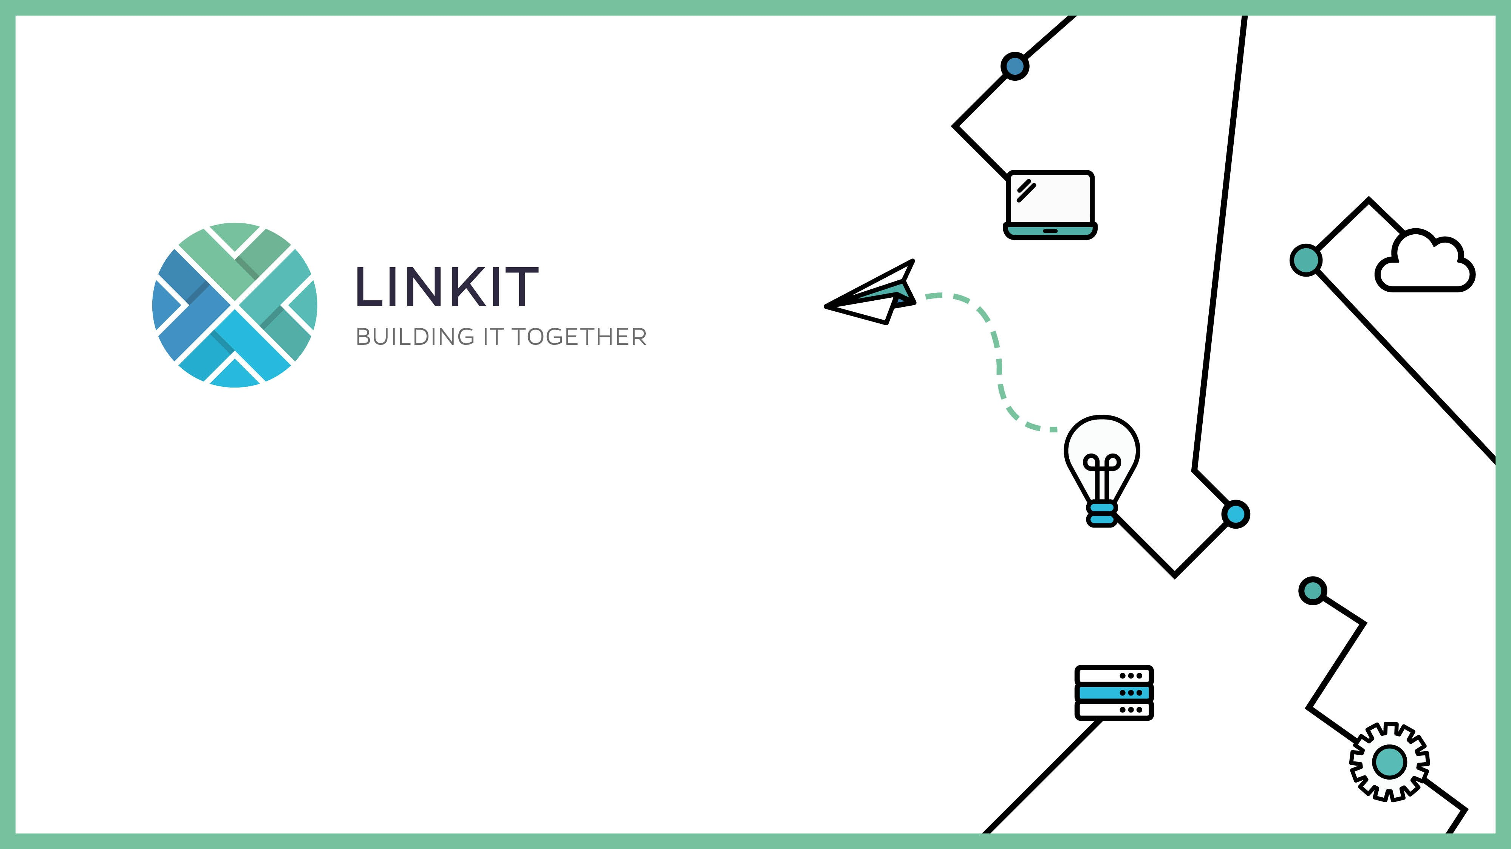
Introduction to Flink
Dana Arsovska
March 12th 2020

Slide 2



Outline
Data Processing & Limitations of Batch Processing
Stateful Stream Processing
Flink Components
Flink vs Spark
Exercises

Slide 3
DATA PROCESSING

Slide 4
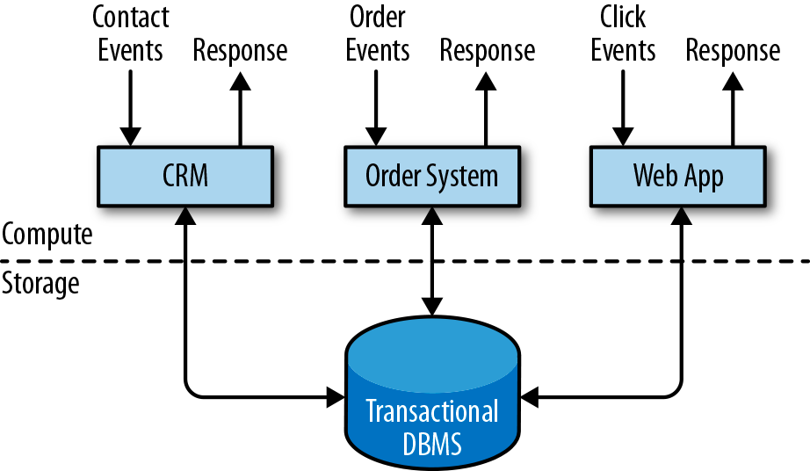
DATA PROCESSING
Transactional Processing
Separation between:
data processing (the application itself)
and data storage (a database)
Applications process incoming events:
Orders, emails, clicks
The app reads the state and updates the DB
Often one DB serves multiple apps

Slide 5
DATA PROCESSING
Transactional Processing
What if we need to make changes?
Change schema?
Scale the DB?
Use different programming language for the order system?
Tight binding makes this difficult!

Slide 6
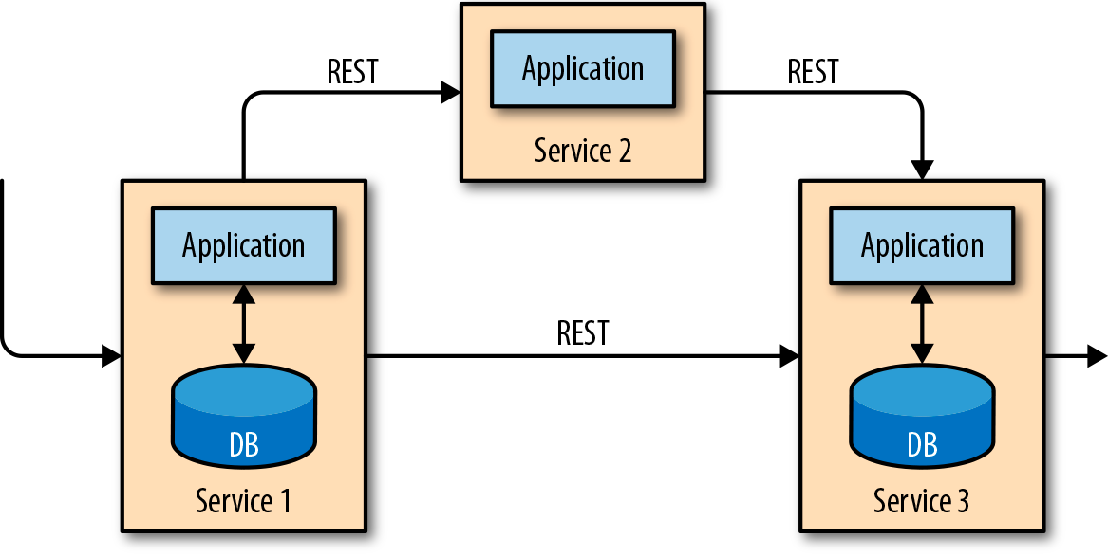
DATA PROCESSING
Transactional Processing
How can we decouple the application?
Microservices!
Each service does a single thing
RESTful HTTP connections

Slide 7
DATA PROCESSING
Transactional Processing
Data stored in transactional databases provides valuable insights.
Sales growth, reasons for delayed shipments, predict future sales
However data is distributed across several disconnected databases
Joining?
Permissions?
Does it have the same format?
It is more valuable if it can be jointly analyzed

Slide 8
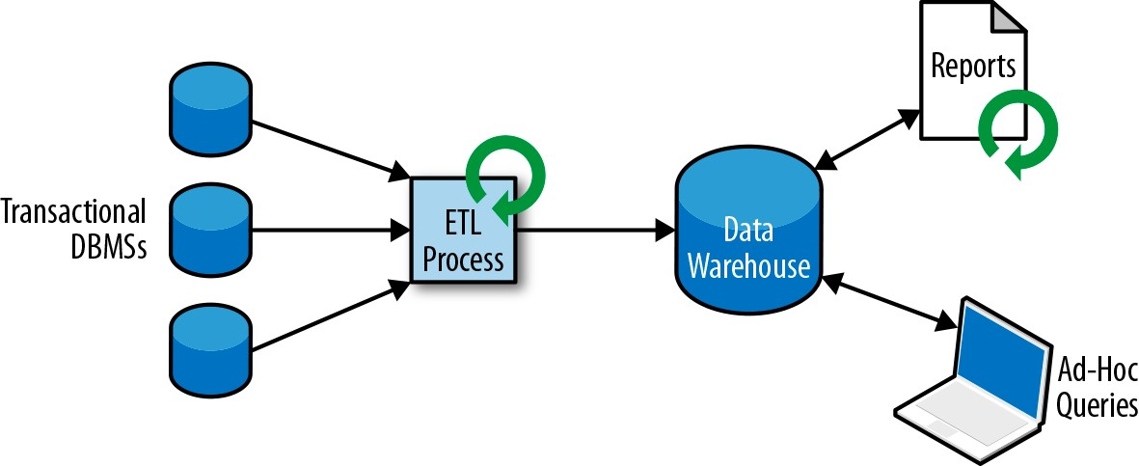
DATA PROCESSING
Analytical Processing
Data warehouse: a dedicated datastore for analytical query workloads
ETL: copying data to the warehouse
Extract data from a transactional database
Transform the data (normalization, validation, deduplication, schema transformation)
Load into the warehouse
Notes:
Like change the schema, or scaling a database

Slide 9
DATA PROCESSING
Analytical Processing
Once the data is in the warehouse we can run queries:
Periodic report queries (yearly revenue, quarter production)
Ad-hoc queries (effectiveness of the latest marketing campaign, spending on radio commercials)
This very useful but we can only do Batch Processing!
Notes:
Like change the schema, or scaling a database

Slide 10
DATA PROCESSING
Stateful Stream Processing
Virtually all data is created as a stream
Sensor measurements
User interaction on a website/mobile app
Order placement
Try to think of an example of a finite complete dataset that was generated in one go?
Notes:
Like change the schema, or scaling a database

Slide 11
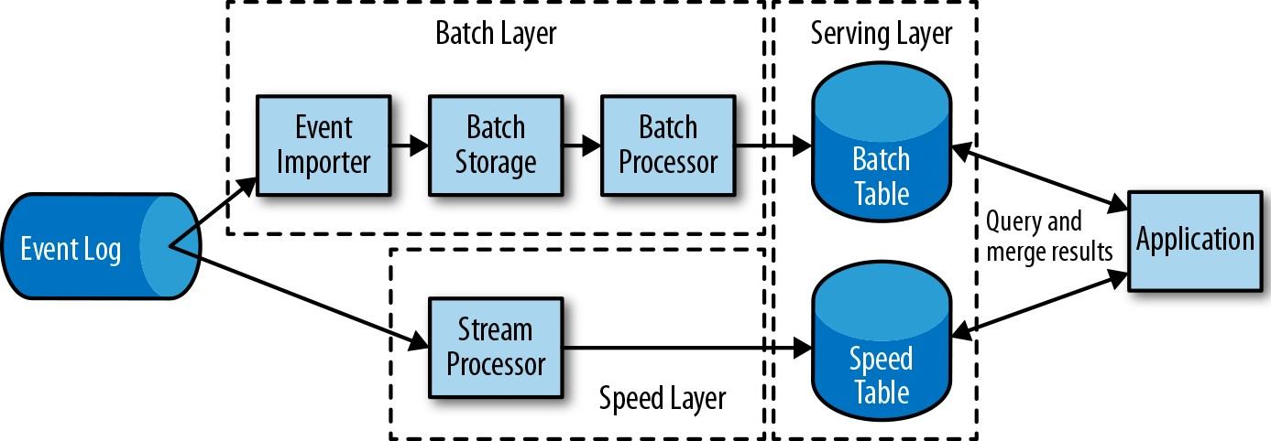
Open Source Stream Processing Evolution
Initially there was a trade off between speed or accuracy
Lambda tried to fix this
Notes:
Like change the schema, or scaling a database

Slide 12
Open Source Stream Processing Evolution
Drawbacks:
Two equivalent implementations of the application logic
The results computed by the stream processor are only approximate
Hard to set up and maintain
Notes:
Like change the schema, or scaling a database

Slide 13
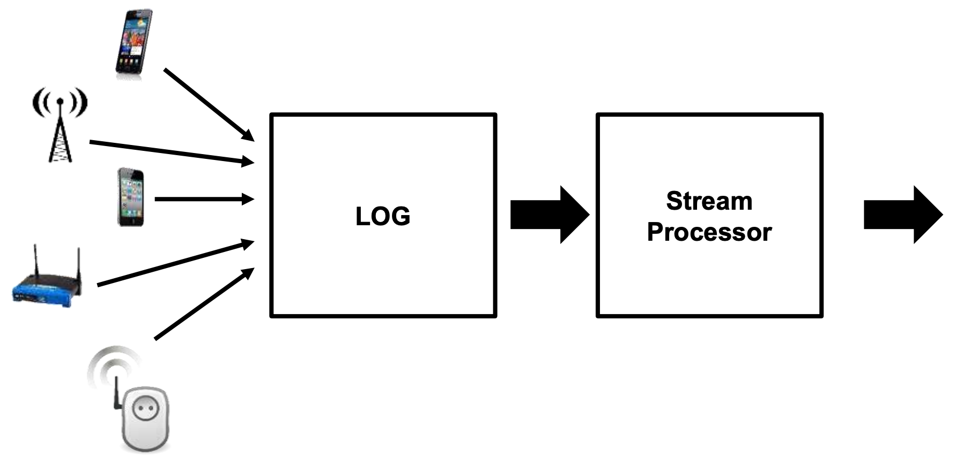
DATA PROCESSING
Stateful Stream Processing
Notes:
Like change the schema, or scaling a database

Slide 14
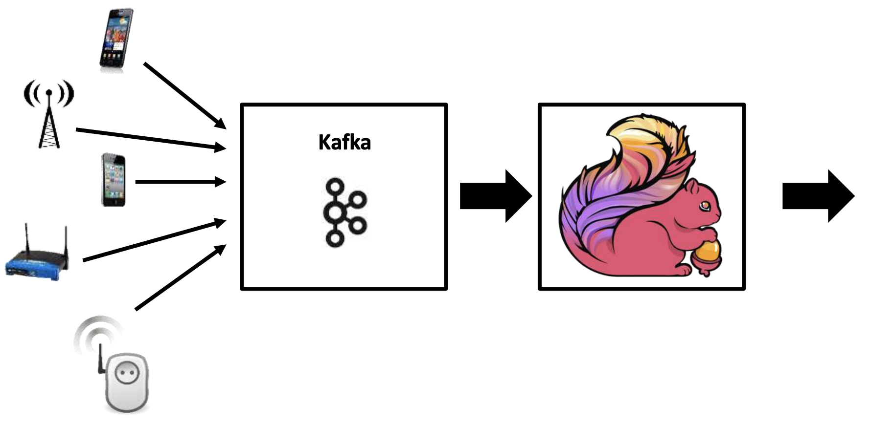
DATA PROCESSING
Stateful Stream Processing
Notes:
Like change the schema, or scaling a database

Slide 15
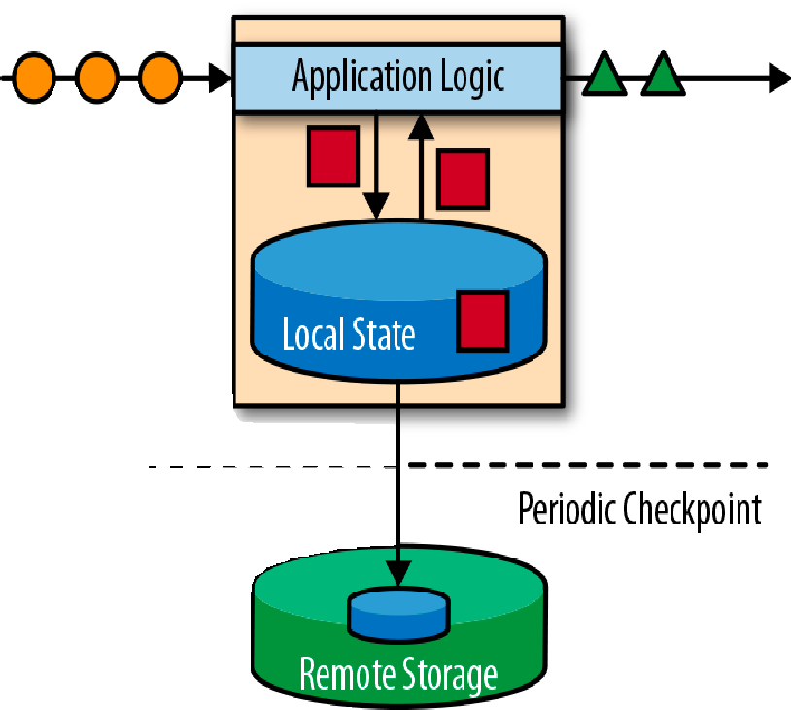
DATA PROCESSING
Stateful Stream Processing
Stateful stream processing is an application design pattern for processing unbounded streams of events.
Application state
We need to store results of intermediate computations
AKA local state
Checkpoint stores the local state to a remote storage
Protects against failures & data loss
Notes:
Like change the schema, or scaling a database

Slide 16
DATA PROCESSING
Stateful Stream Processing
Applications that can be implemented using stateful stream processing:
event-driven applications
data pipeline applications
data analytics applications
Notes:
Like change the schema, or scaling a database

Slide 17
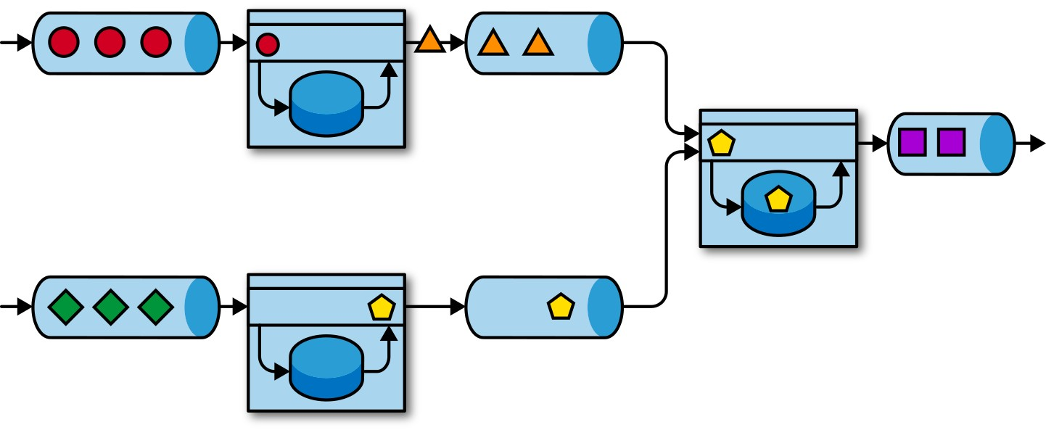
DATA PROCESSING
Stateful Stream Processing: Event-Driven Applications
Evolution of microservices
They communicate via event logs → reliable storage and can be deterministically replayed
Hold application data as local state instead of writing it to and reading it from an external datastore → faster
Notes:
Like change the schema, or scaling a database

Slide 18
DATA PROCESSING
Stateful Stream Processing: Event-Driven Applications
Application
Trigger actions such as sending an alert or an email
Write events to an outgoing event stream to be consumed by another event-driven application.
Typical use cases:
Real-time recommendations (e.g., for recommending products while customers browse a retailer’s website)
Pattern detection or complex event processing (e.g., for fraud detection in credit card transactions)
Anomaly detection (e.g., to detect attempts to intrude a computer network)
Notes:
Like change the schema, or scaling a database

Slide 19

DATA PROCESSING
Stateful Stream Processing: Data Pipelines
Ingesting, transforming, and inserting data with low latency
SQL NoSQL
Queue Cache
Object Storage
SQL NoSQL
Queue Cache
Object Storage
STATEFUL STREAM PROCESSING
Notes:
Like change the schema, or scaling a database

Slide 20
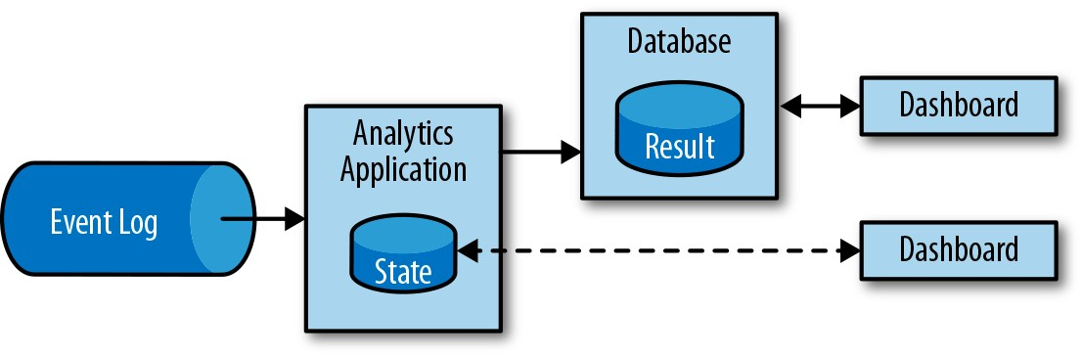
DATA PROCESSING
Stateful Stream Processing: Streaming Analytics
Running batch queries introduces a latency
Sometimes we need real-time processing:
Think of mobile games, monitoring the quality of cellphone networks, fraud detection, or online shopping recommendations
Notes:
Like change the schema, or scaling a database

Slide 21
Stream Processing Basics

Slide 22
Stream Processing Basics

Slide 23
Stream Processing Basics
Finite vs Infinite data
We want up to date results
Don’t wait for the nightly batch job

Slide 24
Stream Processing Basics
Track user satisfaction in web shops
Fraud detection
Game stats
Mobile carriers
IOT
What do they have in common? Counting things over period of time.

Slide 25
Stream Processing Basics
Data Stream: potentially unbounded sequence of events.
Events: monitoring data, sensor measurements, credit card transactions, weather station observations, online user interactions, web searches, etc.

Slide 26
Stream Processing Basics
Parallel stream processing

Slide 27
Stream Processing Basics
Parallel stream processing

Slide 28
Stream Processing Basics
Metrics
Batch: total execution time of a job
Stream:
how long it takes for an event to be processed - Latency (ms)
processing capacity – Throughput (operations per time unit)
Notes:
Since streaming applications run continuously and the input is potentially unbounded, there is no notion of total execution time in data stream processing.
Latency example: coffee shop When you enter the coffee shop, there might be other customers inside already. Thus, you wait in line and when it is your turn you place an order. The cashier receives your payment and passes your order to the barista who prepares your beverage. Once your coffee is ready, the barista calls your name and you can pick up your coffee from the counter. The service latency is the time you spend in the coffee shop, from the moment you enter until you have your first sip of coffee.
Revisiting the coffee shop example, if the shop is open from 7 a.m. to 7 p.m. and it serves 600 customers in one day, then its average throughput would be 50 customers per hour. While you want latency to be as low as possible, you generally want throughput to be as high as possible.

Slide 29
Stream Processing Basics
Metrics
Latency vs Throughput
Events take a long time to travel through the data processing pipeline → low throughput
Small system’s capacity results in buffered events → high latency
No load vs a lot of load?
A lot of time to process an event?
Lowering latency increases throughput
Notes:
Let’s revisit the coffee shop example to clarify how latency and throughput affect each other. First, it should be clear that there is optimal latency when there is no load. That is, you will get the fastest service if you are the only customer in the coffee shop. However, during busy times, customers will have to wait in line and latency will increase. Another factor that affects latency and consequently throughput is the time it takes to process an event, or the time it takes for each customer to be served in the coffee shop. Imagine that during the Christmas holiday season, baristas have to draw a Santa Claus on the cup of each coffee they serve. This means the time needed to prepare a single beverage will increase, causing each person to spend more time in the coffees hop, thus lowering the overall throughput.

Slide 30
Stream Processing Basics
Operations on Data Streams
Transformation operations: transform one event at a time based on a certain logic
Notes:
Let’s revisit the coffee shop example to clarify how latency and throughput affect each other. First, it should be clear that there is optimal latency when there is no load. That is, you will get the fastest service if you are the only customer in the coffee shop. However, during busy times, customers will have to wait in line and latency will increase. Another factor that affects latency and consequently throughput is the time it takes to process an event, or the time it takes for each customer to be served in the coffee shop. Imagine that during the Christmas holiday season, baristas have to draw a Santa Claus on the cup of each coffee they serve. This means the time needed to prepare a single beverage will increase, causing each person to spend more time in the coffees hop, thus lowering the overall throughput.

Slide 31
Stream Processing Basics
Operations on Data Streams
Rolling aggregations: min, max, sum
Notes:
Let’s revisit the coffee shop example to clarify how latency and throughput affect each other. First, it should be clear that there is optimal latency when there is no load. That is, you will get the fastest service if you are the only customer in the coffee shop. However, during busy times, customers will have to wait in line and latency will increase. Another factor that affects latency and consequently throughput is the time it takes to process an event, or the time it takes for each customer to be served in the coffee shop. Imagine that during the Christmas holiday season, baristas have to draw a Santa Claus on the cup of each coffee they serve. This means the time needed to prepare a single beverage will increase, causing each person to spend more time in the coffees hop, thus lowering the overall throughput.

Slide 32
Stream Processing Basics
Operations on Data Streams
Window operations
Rolling aggregations encode the history of the whole stream
Sometimes we only care about most recent data (for example traffic)

Slide 33
Stream Processing Basics
Count-based tumbling window
Time-based tumbling window

Slide 34
Stream Processing Basics
Time semantics
Example: mobile game – if you pop 500 bubbles within a minute you level-up

Slide 35
Stream Processing Basics
Time semantics: Processing time
Will not take into account the disconnected time (only cares about the local clock)
Notes:
Thus, for applications where speed is more important than accuracy, processing time comes in handy

Slide 36
Stream Processing Basics
Time semantics: Event time
Time when an event in the stream actually happened. Event time is based on a timestamp that is attached to the events of the stream.
Notes:
More accurate, deterministic, better
Consider Bob, another player of the online mobile game, who happens to be on the same train as Alice. Bob and Alice play the same game but have different mobile providers. While Alice’s phone loses connection when inside the tunnel, Bob’s phone remains connected and delivers events to the gaming application.

Slide 37
Stream Processing Basics
Time semantics
How long do we have to wait before we can be certain that we have received all events that happened before a certain point of time?
It depends :)
Do we care more about latency or throughput?
Eager watermarks ensure low latency but provide lower confidence.
On the other hand if we wait for too long, we will have higher confidence but also high latency.
Notes:
On the other hand, if watermarks are too relaxed, you have high confidence but you might unnecessarily increase processing latency

Slide 38
Flink Basics

Slide 39
What is Flink?
Apache Flink is an open source platform for scalable stream and batch data processing. It offers expressive APIs to define batch and streaming data flow programs and a robust and scalable engine to execute these jobs.
Project repo: https://github.com/apache/flink

Slide 40
What is Flink?
Data Stream Processing
Realtime results from data streams
Batch Processing
Process static & historic data
Event-driven Applications
Data-driven actions and services

Slide 41
What is Flink?

Slide 42
What is Flink?
Stateful computations over streams

Slide 43
Why Flink?
Event-time & Processing-time
Exactly-once consistency
Low latency
Layered API’s
Lots of connectors
HA setup
Update &/or Migrate without losing state
Lots of metrics by default
Also batch!

Slide 44
Use cases
Optimize search rankings in real time
Real-time process monitoring and ETL
Amazon Kinesis Data Analytic
uses Apache Flink in part to power
its Java application capability
Uber built their internal SQL-based,
open-source streaming analytics
platform AthenaX on Apache Flink
Source: https://flink.apache.org/poweredby.html

Slide 45
Use cases
Single’s day: Chinese Shopping Festival
Very high peak load
100s millions records per second
100s thousands payments per second
10 TBs of managed state
10s thousands of cores
Flink used in various areas in the process incl. payment, shipping, real-time recommendations and the giant dashboard
Sources:
https://www.ververica.com/blog/singles-day-2018-data-in-a-flink-of-an-eye
https://medium.com/@alitech_2017/how-to-cope-with-peak-data-traffic-on-11-11-the-secrets-of-alibaba-stream-computing-17d5e807980c

Slide 46
Flink Components
The Dispatcher provides a REST interface to submit applications for execution. Once an application is submitted for execution, it starts a JobManager and hands the application over.

Slide 47
Flink Components
The JobManager is the master process that controls the execution of a single application.
Each application is controlled by a different JobManager.
The JobManager receives an application for execution.

Slide 48
Flink Components
The ResourceManager is responsible for managing TaskManager slots,
TaskManagers are the worker processes of Flink. Each TaskManager provides a certain number of slots.
When a JobManager requests TaskManager slots, the ResourceManager instructs a TaskManager with idle slots to offer them to the JobManager.

Slide 49
Flink Components
The ResourceManager is responsible for managing TaskManager slots, Flink’s unit of processing resources.
When a JobManager requests TaskManager slots, the ResourceManager instructs a TaskManager with idle slots to offer them to the JobManager.

Slide 50
Layered APIs

Slide 51
What can be streamed?
The DataStream APIs for Java and Scala will let you stream anything they can serialize.
basic types, i.e., String, Long, Integer, Boolean, Array
composite types: Tuples, POJOs, and Scala case classes
Docs: https://ci.apache.org/projects/flink/flink-docs-stable/dev/datastream_api.html

Slide 52
Flink App Structure
Typical Flink streaming application structure:
1. Set up the execution environment.
2. Read one or more streams from data sources.
3. Apply streaming transformations to implement the application logic.
4. Optionally output the result to one or more data sinks.
5. Execute the program.

Slide 53
Flink App Structure
Set Up Execution Environment
// create a local stream execution environment val localEnv: StreamExecutionEnvironment.createLocalEnvironment() // create a remote stream execution environment val remoteEnv = StreamExecutionEnvironment.createRemoteEnvironment( "host", // hostname of JobManager 1234, // port of JobManager process "path/to/jarFile.jar") // JAR file to ship to the JobManager

Slide 54
Flink App Structure
Read one or more streams from data sources
val sensorData: DataStream[SensorReading] = env.addSource(new SensorSource)
val text = env.socketTextStream("localhost", 9999)
val kinesis = env.addSource(new FlinkKinesisConsumer[String](
"kinesis_stream_name", new SimpleStringSchema, consumerConfig))
val stream = env.addSource(new FlinkKafkaConsumer08[String](
"topic", new SimpleStringSchema(), properties))

Slide 55

Flink App Structure
Apply transformations
Map
val readings: DataStream[SensorReading] = ... val sensorIds: DataStream[String] = readings.map(r => r.id)
Extracts the first field (id) of each SensorReading in the input stream

Slide 56
Flink App Structure
Apply transformations
Filter
val readings: DataStream[SensorReadings] = ... val filteredSensors = readings.filter( r => r.temperature >= 25 )
Drop all sensor measurements with temperature below 25°F

Slide 57
Flink App Structure
Apply transformations
FlatMap
val sentences: DataStream[String] = ... val words: DataStream[String] = sentences .flatMap(id => id.split(" "))
Split each sentence by the space character, and emit each resulting word as an individual record

Slide 58
Flink App Structure
Apply transformations
Rolling aggregations
sum(): A rolling sum of the input stream on the specified field.
min(): A rolling minimum of the input stream on the specified field.
max(): A rolling maximum of the input stream on the specified field.
val inputStream: DataStream[(Int, Int, Int)] = env.fromElements((1, 2, 2), (2, 3, 1), (2, 2, 4), (1, 5, 3)) val resultStream: DataStream[(Int, Int, Int)] = inputStream .keyBy(0) // key on first field of the tuple .sum(1) // sum the second field of the tuple in place
(1,2,2) followed by (1,7,2) for the key 1
(2,3,1) followed by (2,5,1) for the key 2

Slide 59
Flink App Structure
Output the result
Simple print
Output to an external system: Kafka, filesystem, database

Slide 60
Flink App Structure
Execute
Lazy execution – nothing is computed until execute is called!
env.execute("Compute temperature")

Slide 61
Spark Streaming vs Apache Flink
 | Spark Streaming | Apache Flink
Gurantee | Exactly Once
Throughput | High
Overhead of Fault Tolerance | Low
Computation Model | Micro Batches | Streaming
Window Criteria | Time Based | Record Based or User Defined
Memory | Configured | Automatic
Notes:
Gurantee: every record will be processed exactly once, eliminating any duplicates

Slide 62
Spark Streaming vs Apache Flink
Batch
Micro Batch
Continuous Flow Operator
Notes:
Microbatch: Take buckets of water, Flow is free flow

Slide 63
Spark Streaming vs Apache Flink
Use cases
Industry | Micro Batch/Real Time | Real Time
Finance | Credit card fraud detection | Fraud prevention
Spam | Detect spam | Spam prevention
Mobile phone industry | Usage aggregation (like calculating bandwith per user, spending etc.) | Network anomaly detection
IOT | Plotting trend lines | Alert when a threshold is reached
Notes:
Microbatch: Take buckets of water, Flow is free flow

Slide 64
Let’s create our first Flink application!
Go to:
https://github.com/Dzvezdana/introduction-to-flink

Slide 65
Interested to learn more?
Some things that are important, but we didn’t cover: - ProcessFunction API
Fraud detection in ING using Flink: https://www.ververica.com/blog/real-time-fraud-detection-ing-bank-apache-flink
Introduction to Stateful Stream Processing with Apache Flink by Robert Metzger: https://www.youtube.com/watch?v=DkNeyCW-eH0
Kafka + Flink: A Practical, How-To Guide: https://www.ververica.com/blog/kafka-flink-a-practical-how-to
Ververica’s Flink training: https://training.ververica.com/
https://flink.apache.org/blog/
https://ci.apache.org/projects/flink/flink-docs-stable/
https://github.com/dcos/demos

